Slide 1
DFRobot Arduino Coding Standard
By Angelo

Slide 2
Purpose

Slide 3

Readability
Cooperation
Manageable

Slide 5
Make money

Slide 6
From whom

Slide 7
Our God

Slide 8
Our God
Most of them are beginners.
Care about Project rather than Code
They're not stupid for not under-standing technical concept

Slide 9
Keep in mind whom you are writing code to

Slide 10
Guiding principle
Efficiency is not supreme, readability is.
Code should explain itself, or use comments to do the same.
When forced to choose between technically simple and technically efficient, choose the former.
Introduce concepts only when they are useful and try to minimise the number of new concepts you introduce in each example.

Slide 11
The evolution of the URM06 library
1. urm06.readDistance();
2. while(!urm06.requestDistance()){if(urm06.available()){…}}
if(urm06.available()){…}
3. urm06.requestDistance();
urm06.requestTemperature();
if(urm06.available()){…}
4. urm06.readDistance();

Slide 12
The evolution of the PlainProtocol
1. plainProtocol.init();
2. plainProtocol.begin(115200);

Slide 13
The evolution of the PlainProtocol
1. if(plainProtocol.receiveFrame()){
}
2. if(plainProtocol.available()){
}

Slide 14
The evolution of the PlainProtocol
1. if (plainProtocol.receivedCommand=="Motor") {
motorSpeed[0]=plainProtocol.receivedContent[0];
motorSpeed[1]=plainProtocol.receivedContent[1]; }
2. if (plainProtocol.equals(“Motor”)) {
motorSpeed[0]=plainProtocol.read();
motorSpeed[1]=plainProtocol.read(); }
3. if (plainProtocol==“Motor”) {
motorSpeed[0]=plainProtocol.read();
motorSpeed[1]=plainProtocol.read(); }

Slide 15
The evolution of the PlainProtocol
1. plainProtocol.sendFrame(“Motor”,2,-200,200);
2. plainProtocol.write(“Motor”,-200,200);
3. plainProtocol.startTransmission(“Motor”);
plainProtocol.write(-200);
plainProtocol.write(200);
plainProtocol.endTransmission();

Slide 16

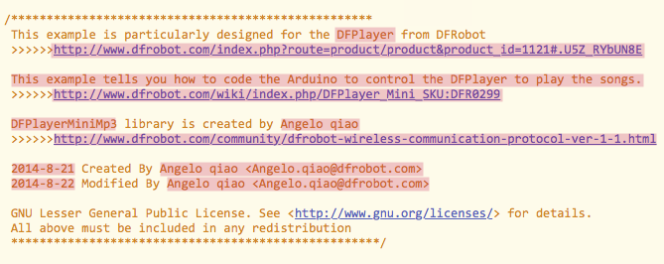
DFRobot Title Block

Slide 17

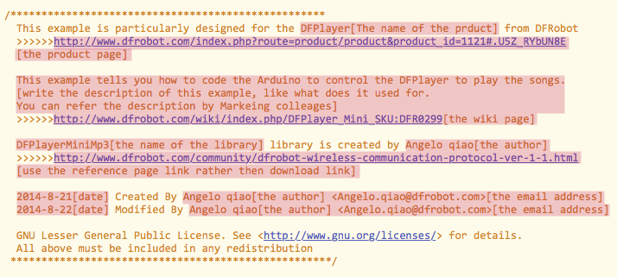
DFRobot Title Block
with explanation

Slide 18

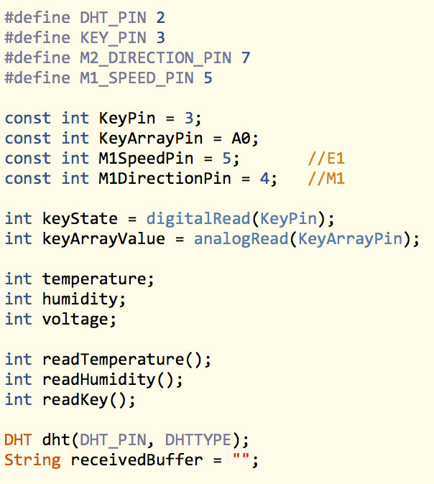
Naming
Use camel case, no underscore
Use full, everyday words
Capitalise first letter of const variable
Use uppercase and underscore after #define

Slide 19
Recommend naming
Use camel case of Class as object name
Use “Pin” for pin variable
Use “State” for digital variable
Use “Value” for analog variable
Use “A0” instead of “0” for analogPin

Slide 20

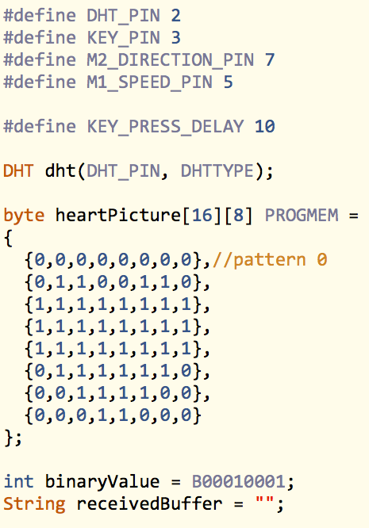
Tips
Use “PROGMEM” to save memory
Use “B00010001” to denote the binary number

Slide 21

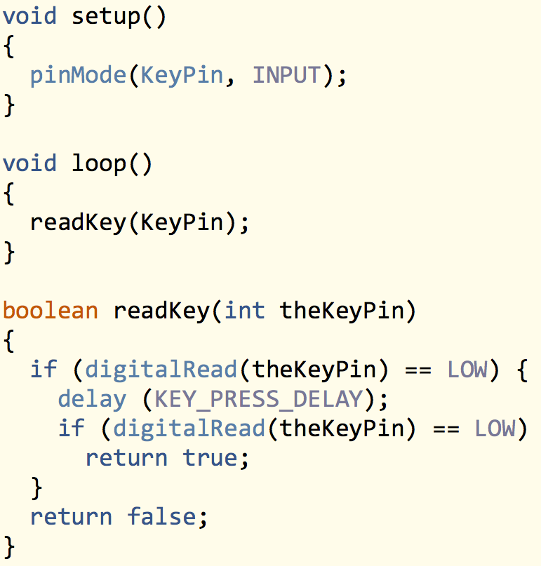
Tips
Put your setup() and your loop() at the beginning of the program
Add “the” before the parameter of the function

Slide 22

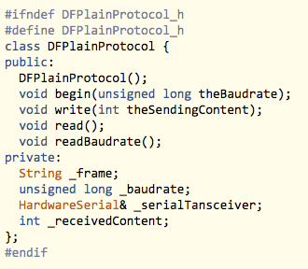
Class Naming
Add “DF” before the Class name
Add “_” before the private variables
Use functions instead of public variables.

Slide 23

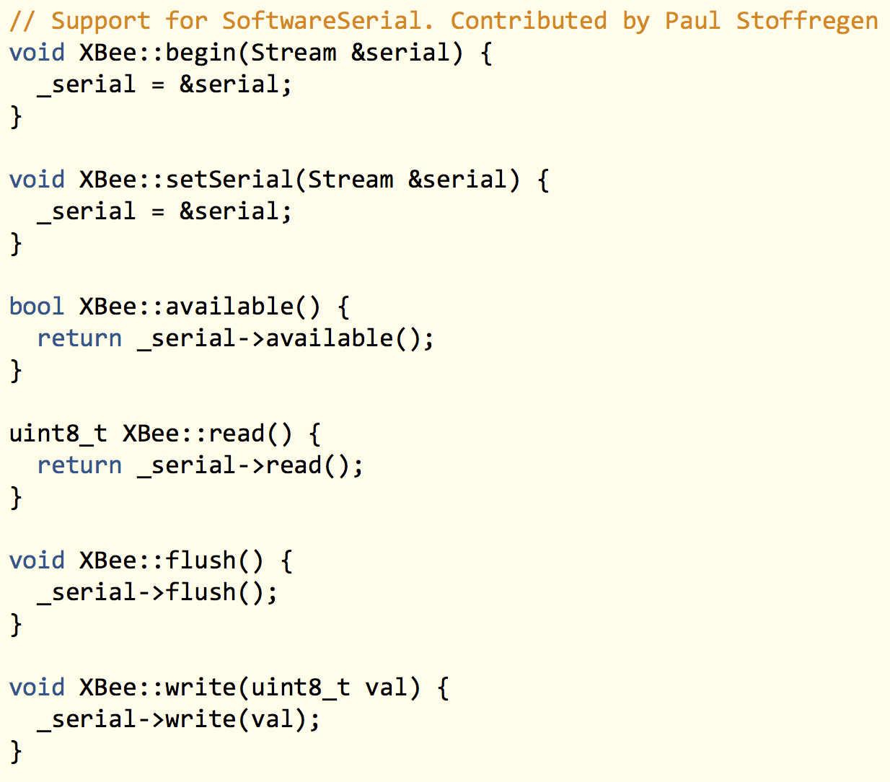
Class Tips
Use read() to read inputs, and write() to write to outputs
Use the Stream.h and Print.h libraries when dealing with byte streams
For network applications, use the Client and Server libraries as the basis.
Use begin() to initialise a library instance, usually with some settings. Use end() to stop it.

Slide 24

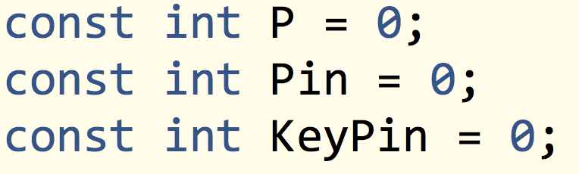
Be more descriptive

Slide 25

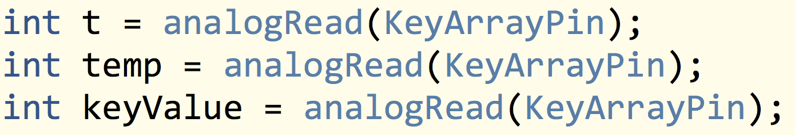
Be more descriptive

Slide 26

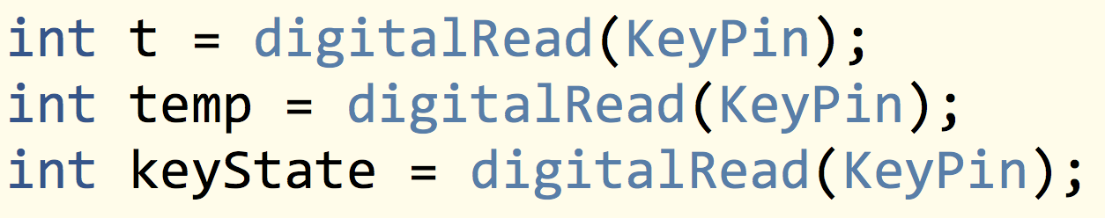
Be more descriptive

Slide 27

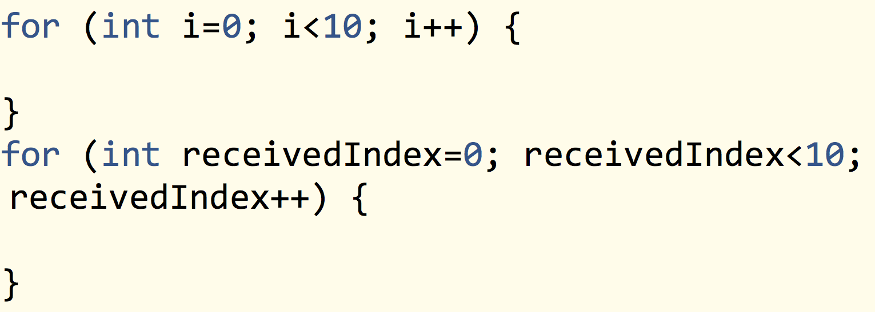
Be more descriptive

Slide 28

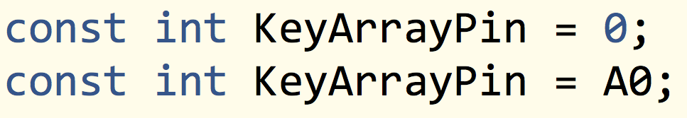
Use “A0” on Analog Pin

Slide 29

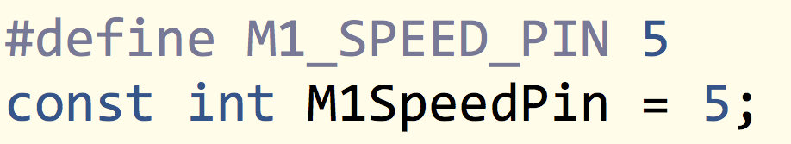
Use const rather than #define

Slide 30

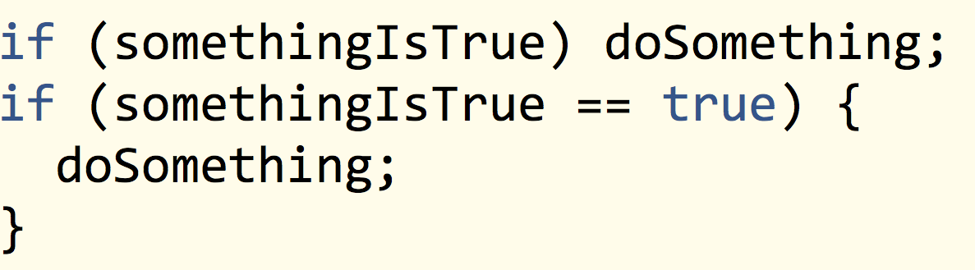
Use block format for everything

Slide 31

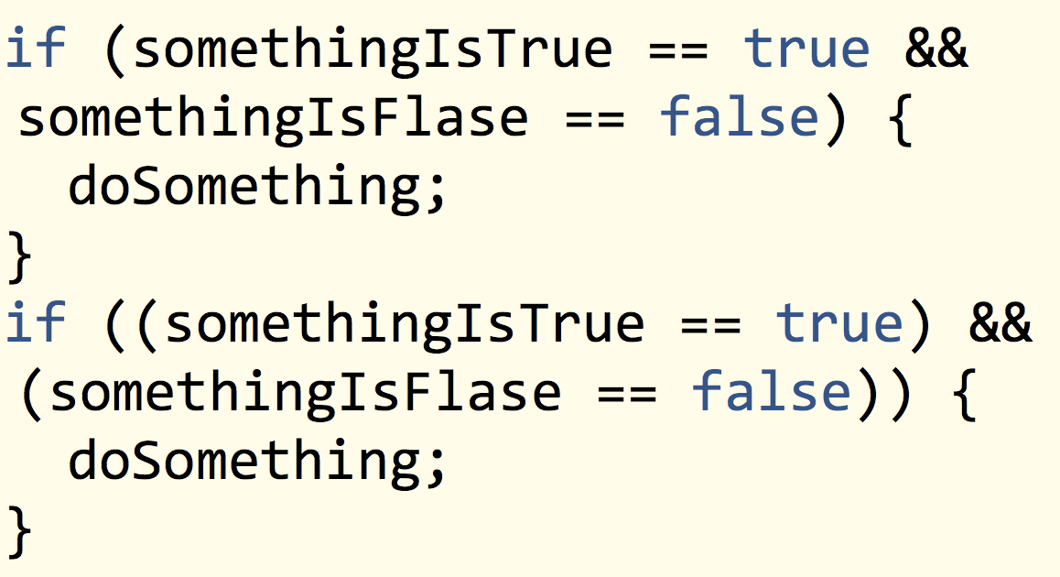
Use more bracket

Slide 32

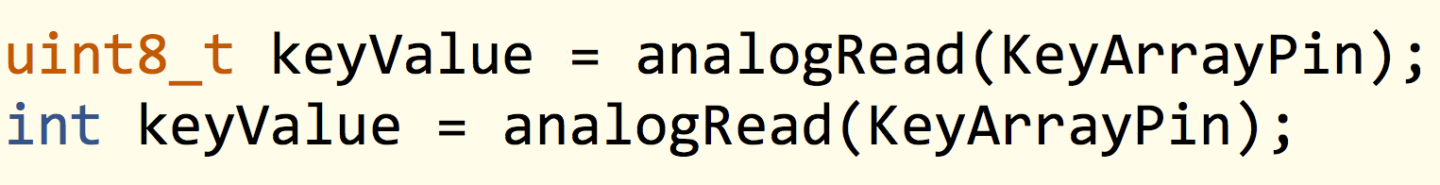
Use standard variable types

Slide 33

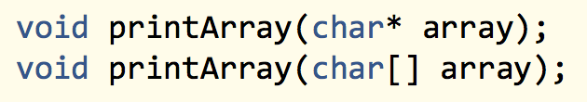
Don’t assume knowledge of pointers

Slide 34

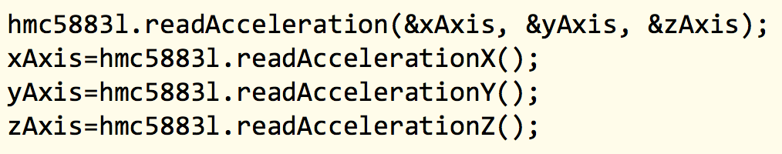
Avoid anything that requires the user to pass them

Slide 35
Search available code on website before write

Slide 36
Sketch classify
Read data from devices
Control real objects
Draw something to display
Communication devices

Slide 37
Thank you

